Slide 1

In-vivo Neuroscience Research and Neuropixels
ELEC5650M Medical Electronics and E-Health

Slide 2
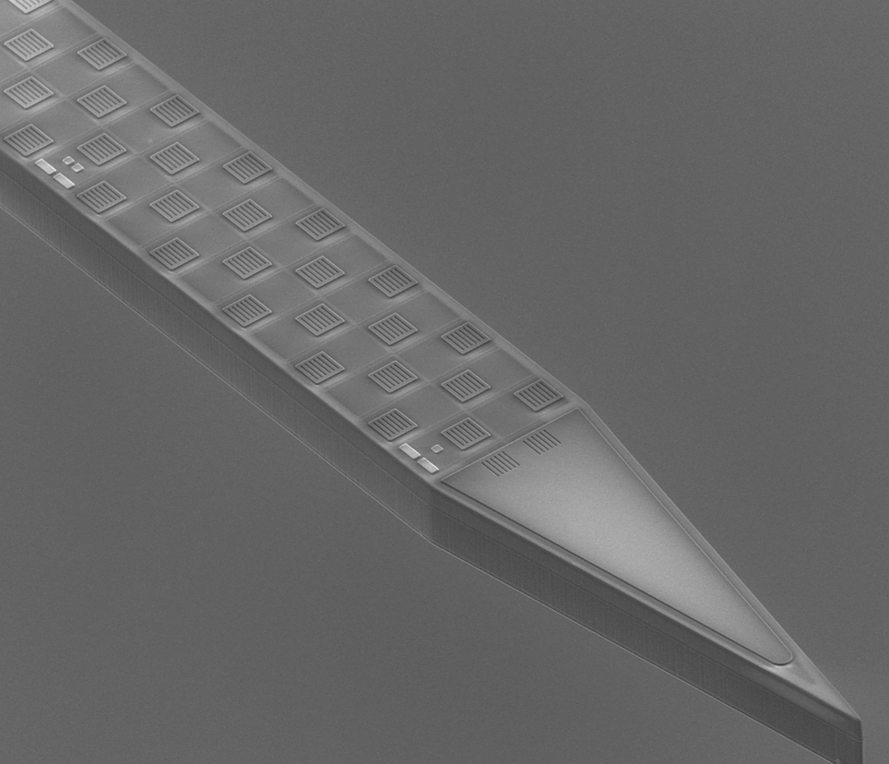
Outline
Part 1: In-vivo Neuroscience Research
Part 2: Microelectrode Array—Utah Array
Part 3: Neuropixels
Part 4: Experimental Research
Part 5: New version: Neuropixels 2.0
Part 6: Conclusion

Slide 3
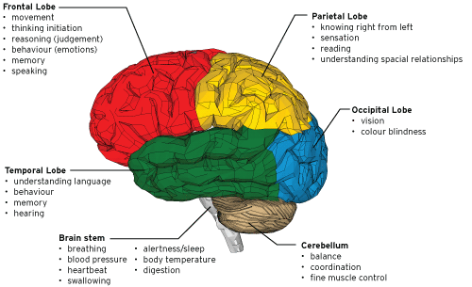
Part 1: In-vivo Neuroscience Research
What is in-vivo neuroscience research and why is it important?
Neuroscience is a biological mechanism that explains mental activity.
Increase our understanding of biology and enable researchers in the future
Find ways to prevent neurological diseases, such as Alzheimer’s disease, Down's syndrome, ADHD.
[1]

Slide 4
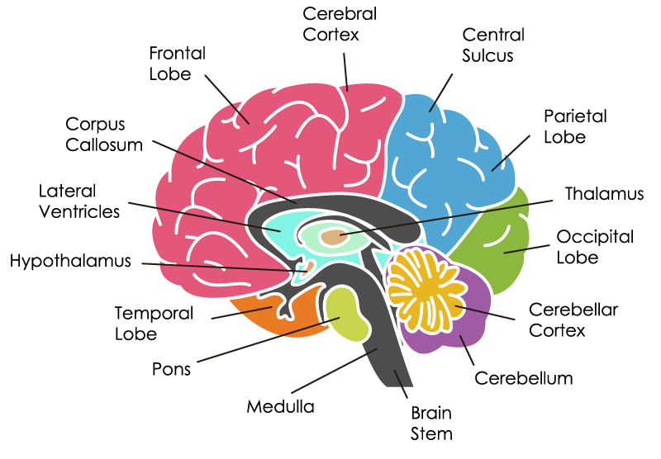
The structure of the brain
The production of every behavior is completed by the collaborative work of different brain areas of the brain.
Neural implantable device
Record the action potentials of biological brain neurons
In the future, brain-computer interface technology can be realized through in-vivo neuroscience research. And this is exactly what Musk's neuralink company is doing (https://neuralink.com).
[2]

Slide 5
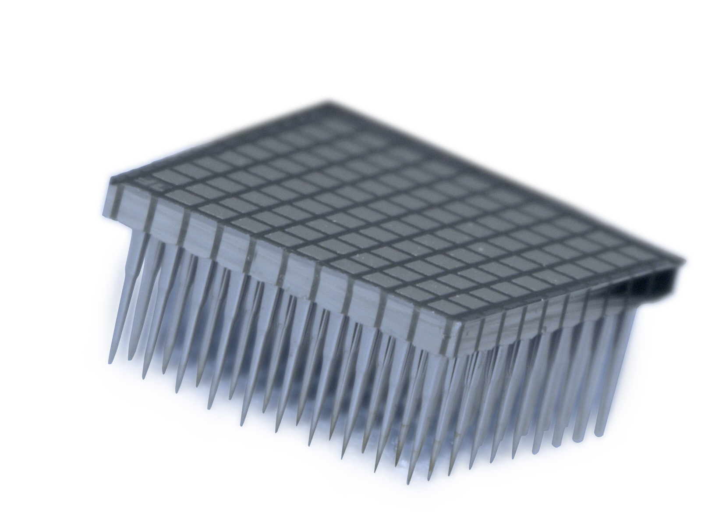
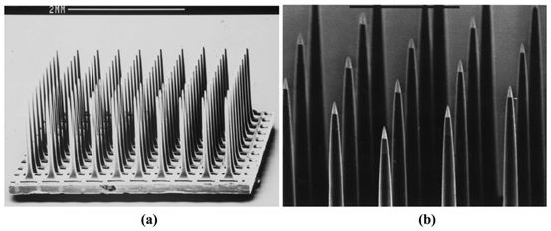
Part 2: Microelectrode Array—Utah Array
Utah Array—A technique used in the past to acquire neural signals
Characteristic：
The electrode length is about 1.0mm or 1.5mm
Use silicon as electrode base material
The size of the base is 4mm*4mm, and nearly 100 electrodes are arranged
[3]
Defect:
Compared with Neuropixels, relatively small electrodes limit the Utah Array to collect more action potential signals.
[4]

Slide 6
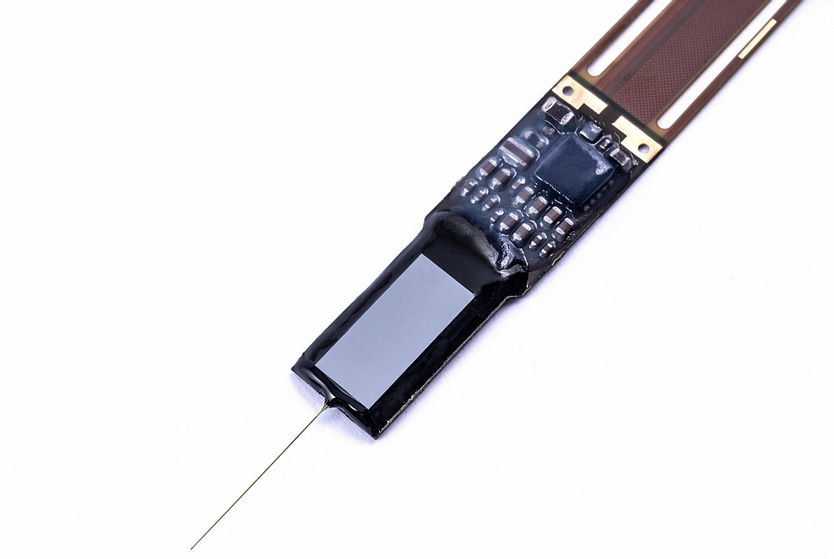
Part 3: Neuropixels
What is Neuropixels:
It is a fully integrated silicon CMOS digital neural probe with a chip design for signal conditioning and digitization. The activity of a large number of neurons can be detected from multiple brain regions with higher fidelity and less difficulty. Probes can perform long-term monitoring and intensive sampling of single cell activity and larger neuron populations in awake and anesthetized animals.
[5]

Slide 7
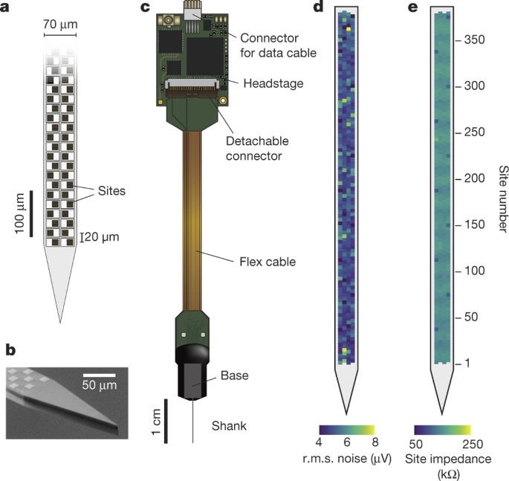
Neuropixels
The probe has 960 recording sites.
The probe is 10mm long (roughly the size of a mouse or rat brain), with a cross-sectional width of 70×20μm, covering 100 recording points per millimeter.
[6]

Slide 8
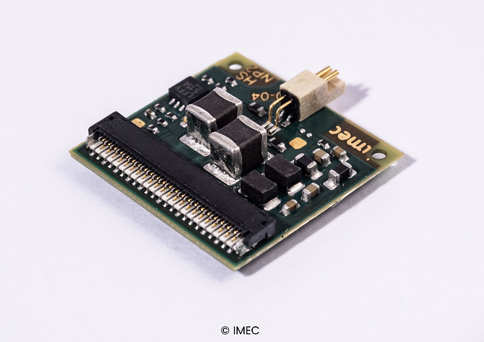
Hardware and software support
The control system consists of three parts: a headstage, an interface cable and a PXIe acquisition module.
Headstage
It’s important for power supply to the probe, probe configuration and bi-directional data communication.
[7]

Slide 9
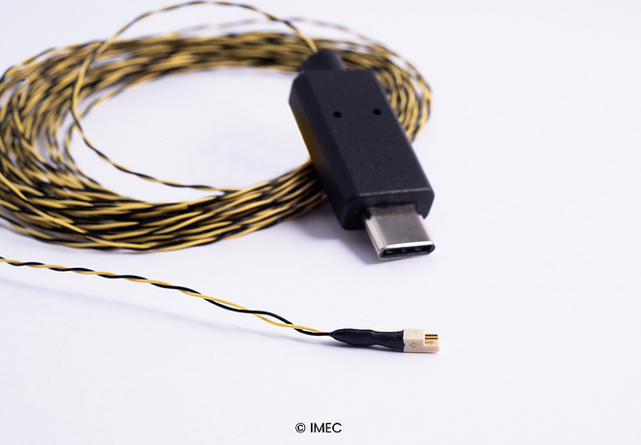
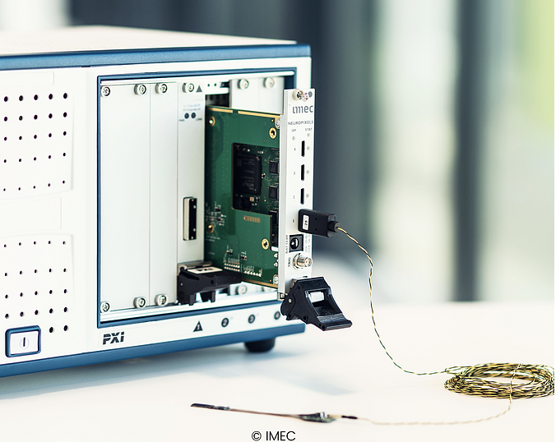
Hardware and software support
Interface Cable
5 m long and 410 x 820 µm thin, used to establish the power and data link between the probe and the PXIe acquisition board.
[7]
PXIe Acquisition Module
It is used for probe configuration, data acquisition and data transmission to PC. Data can be collected from up to 4 probes at the same time.
[7]

Slide 10
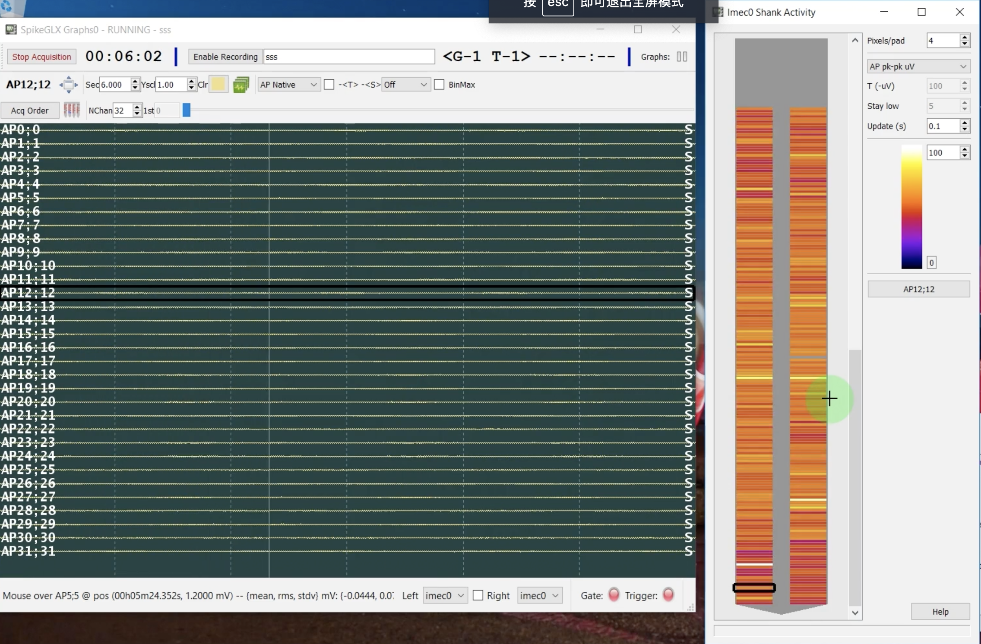
Hardware and software support
The software part can use either SpikeGLX or Open Ephys GUI to collect data.
[8]

Slide 11
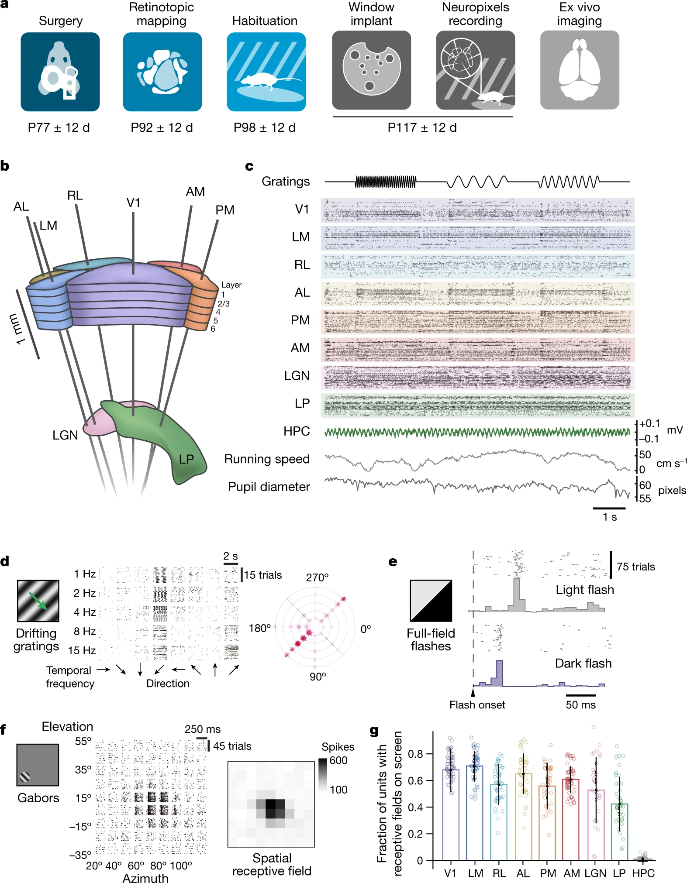
Part 4: Experimental Research
Researchers from the Allen institute for Brain Science used Neuropixels to capture a large number of electrical signals emitted by animals when they parse visual signals.
Such experiments and research results can enable researchers to develop more understanding of the way the brain perceives the external world. This experiment and related results have been published on nature.
Some images and data from the paper
[9]

Slide 12
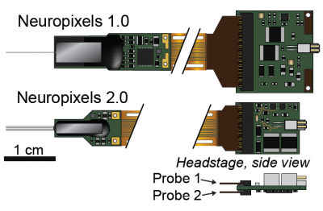
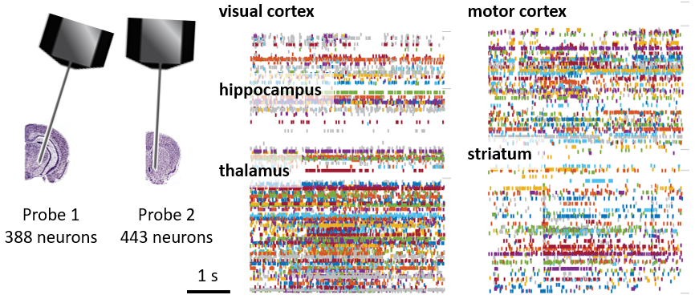
Part 5: New version: Neuropixels 2.0
The size of Neuropixels 2.0 is only one-third the size of the 1.0 probe.
Neuropixels 1.0 probes only have one filament. Neuropixels 2.0 probes have four filaments, which is to enter the brain of mouse.
[11]
[10]

Slide 13
Part 6: Conclusion
This presentation mainly explained the related research and importance of in-vivo neuroscience, especially the two technologies of Utah array and Neuropixels. And it focus on explaining neuropixels’ basic principles, components, experimental research and future trends.
The purpose is to enable readers to have a deeper understanding of this technology.

Slide 14
Reference
“lobes of the brain and their functions - Google Search,” Pinterest. https://www.pinterest.co.uk/pin/793478028074567685/.
“The Brain 101,” BrainHQ from Posit Science. https://www.brainhq.com/brain-resources/cool-brain-facts-myths/brain-101/.
"Utah Array", Blackrockmicro.com, 2021. [Online]. Available: https://www.blackrockmicro.com/electrode-types/utah-array/.
"SEM micrograph of: (a) The Utah array. (b) The insulation coated...", ResearchGate, 2021. [Online]. Available: https://www.researchgate.net/figure/SEM-micrograph-of-a-The-Utah-array-b-The-insulation-coated-electrodes-with-exposed_fig7_26547635.
“Probe,” Neuropixels. https://www.neuropixels.org/probe.
Jun, James J et al. “Fully integrated silicon probes for high-density recording of neural activity.” Nature vol. 551,7679 (2017): 232-236. doi:10.1038/nature24636
"Control System", 2021. [Online]. Available: https://www.neuropixels.org/control-system.
"First_Run", Vimeo, 2021. [Online]. Available: https://vimeo.com/322145679.
J. H. Siegle et al., “Survey of Spiking in the Mouse Visual System Reveals Functional Hierarchy,” Nature, vol. 592, no. 7852, pp. 86–92, Apr. 2021, doi: 10.1038/s41586-020-03171-x.
N. A. Steinmetz et al., “Neuropixels 2.0: A miniaturized high-density probe for stable, long-term brain recordings,” Cold Spring Harbor Laboratory, Oct. 2020. [Online]. Available: http://dx.doi.org/10.1101/2020.10.27.358291.
UCL, “UCL – University College London,” Neuropixels. https://www.ucl.ac.uk/neuropixels/.

